Slide 1
AI Project Spring 2025 Title: “Escape room game and karachi Market Path finder”
Project members:
Adina Faraz (23k-0008)
Syeda Sara Ali (23k-0070)
Raghib Rizwan (23k-0012)
Hafsa Rashid (23k-0064)
Instructor:
Theory: Sir Bilal Ahsan
Lab: Ramsha Jat

Slide 2

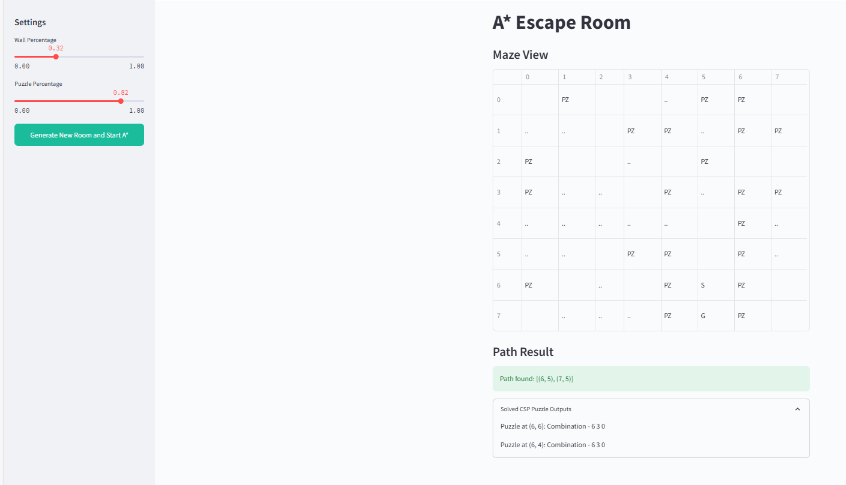
Escape the room
The A* Escape Room Challenge is a fun way to
show how AI solves puzzles.
Players try to escape a maze with locked doors
and obstacles. The system uses the A* algorithm
to find the shortest and best path from
start to goal by considering:
Where the player starts and finishes
Obstacles in the way
Steps needed and estimated distance
This game helps users see how A* works in
real-time, making AI search ideas easy to
understand.

Slide 3
HOW Efficient it is?
Algorithm Used:
A* Search Algorithm (Informed Search)
Finds the shortest and optimal path from start to goal using:
g(n): cost from start to current node
h(n): heuristic (Manhattan distance to goal)
Total cost: f(n) = g(n) + h(n)
CSP Solver (Puzzle Handling):
Backtracking used to solve lock puzzles
Solves by trying all digit combinations that meet constraints
Simple and efficient for small, fixed-size domains (0–9 digits)
Efficiency:
A* is efficient due to heuristic guidance
Time Complexity (worst-case): O(b^d)
b: branching factor (4 directions)
d: depth of the optimal path
Backtracking is fast here due to small puzzle space
Why Backtracking Works Well Here:
Puzzle is small and fixed (3 digits)
No need for complex pruning (like Forward Checking)
Fast and easy to implement

Slide 4
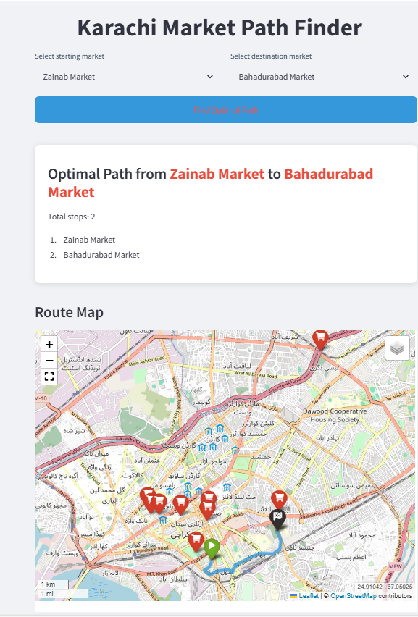
Karachi Market Map
Karachi Market Path Finder:
This module applies A* Search and Constraint Satisfaction Problem (CSP)
techniques to help users find optimal and legal routes through
Karachi’s busy markets. The city is represented as a graph where
each node is a market and each edge is a road, with weights based on
distance, traffic, and road conditions.
A* vs CSP – Simple Comparison:
A* Search is used for finding the shortest and most efficient path
using a cost function f(n) = g(n) + h(n) (actual distance + estimated
distance).
CSP is used to enforce constraints like one-way roads, blocked paths,
or restricted areas, ensuring that all solutions meet given rules.

Slide 5
HOW Efficient it is?
Algorithms:
A* Algorithm:
Time Complexity: O(E) in the worst case (where E is the number of edges) due to exploration of the entire graph.
Efficient in dynamic environments, especially with changing conditions (traffic, road closures).
Ideal for minimum travel time and distance when factors like road closures are considered.
Efficiency:
A* is efficient due to heuristic guidance
Time Complexity (worst-case): O(b^d)
b: branching factor (4 directions)
d: depth of the optimal path
Backtracking is fast here due to small puzzle space

Slide 6
HOW Efficient it is?
Continued…..
CSP (Constraint Satisfaction Problem):
Time Complexity: Depends on the constraints, but generally requires O(n^2) for constraint checks where n is the number of nodes.
Ensures compliance with safety regulations, construction zones, and access restrictions while calculating the optimal path.
Useful for scenarios with non-negotiable constraints like road type limitations or vehicle-specific restrictions.
Why Backtracking Works Well Here:
Puzzle is small and fixed (3 digits)
No need for complex pruning (like Forward Checking)
Fast and easy to implement

Slide 7
How is A star better than UCS?
A* uses heuristics to find the goal faster and expand fewer nodes, but at the cost of more memory.
UCS is simpler and uses less memory, but may explore more paths and take more time.
If we replace A* with UCS, we can expect:
Increased time (more node expansion)
Reduced memory usage
Less optimal guidance toward goal (no heuristic)

Slide 8
Factor | A* Search | Uniform Cost Search (UCS)
Memory Usage | Higher (stores nodes + heuristic values) | Lower (only stores path costs and nodes)
Time Complexity | O(b^d), but more efficient with a good heuristic | O(b^d), may expand more nodes without heuristic
Efficiency | Generally more efficient (guided by heuristic) | Less efficient (blind search based on cost only)

Slide 9
THANK YOU!!!

